Slide 1
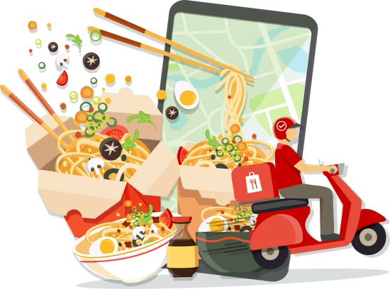
Recommended systems for food delivery app
When choosing a system for food delivery business , it’s essential to consider the software and the logistics that’s will support the order management, delivery tracking and customer experience
By Kavya Ashritha | AP22110010408

Slide 2
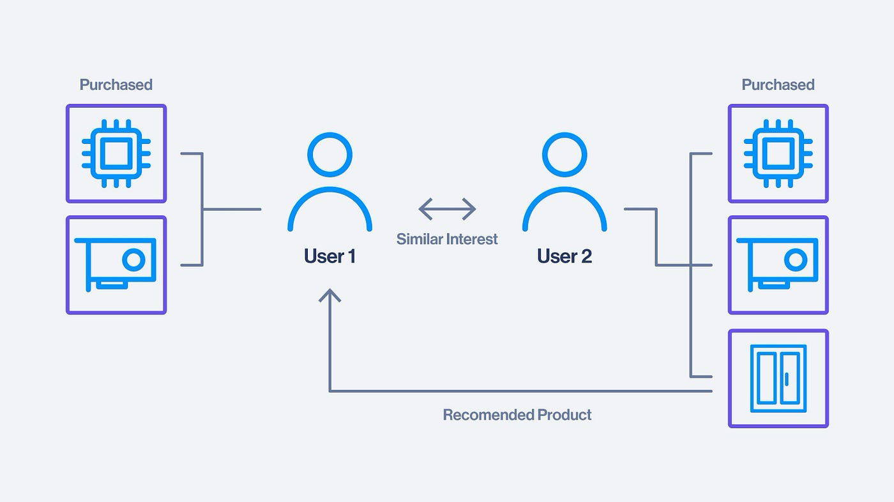
What is a recommender system?
A recommender system in machine learning is a specialized software tool or algorithm designed to suggest products, content, or information to users based on their preferences, behavior, or characteristics. These systems are used widely in e-commerce, streaming platforms, and social media to personalize user experiences. Recommender systems analyze large datasets and try to predict what a user would like based on different types of information.

Slide 3
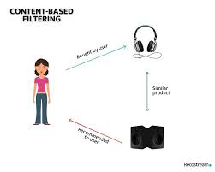
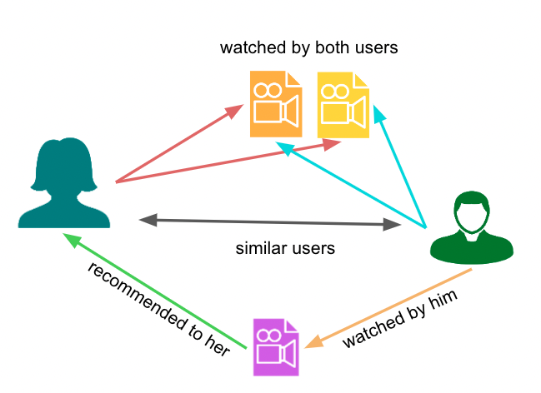

Types of recommender systems
1.
Content-Based filtering
2. Collabrative Filtering
3. Hybrid approaches
This approach makes recommendations based on the attributes of items and user preferences. It analyzes the properties of the item (such as genre, actors, etc., for movies) and tries to match these with what the user has liked in the past.
Collaborative Filtering is a recommendation method that suggests items to users based on the preferences of similar users or the similarity between items. It based on patterns of user behavior.
These systems combine collaborative filtering and content-based filtering to improve recommendation accuracy. By merging multiple approaches.

Slide 4
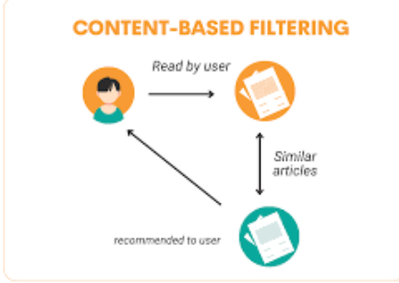
Content based filtering
Analyses Item Attributes
It examines specific characteristics of each item (such -as genre, author, or ingredients) to understand what defines that item.
User Preference
Recommends items with similar attributes to those the user has liked before.
Personalized preference
Focuses on the individual’s history, creating a tailored experience without relying on other users' data.
Notes:
Kow

Slide 5
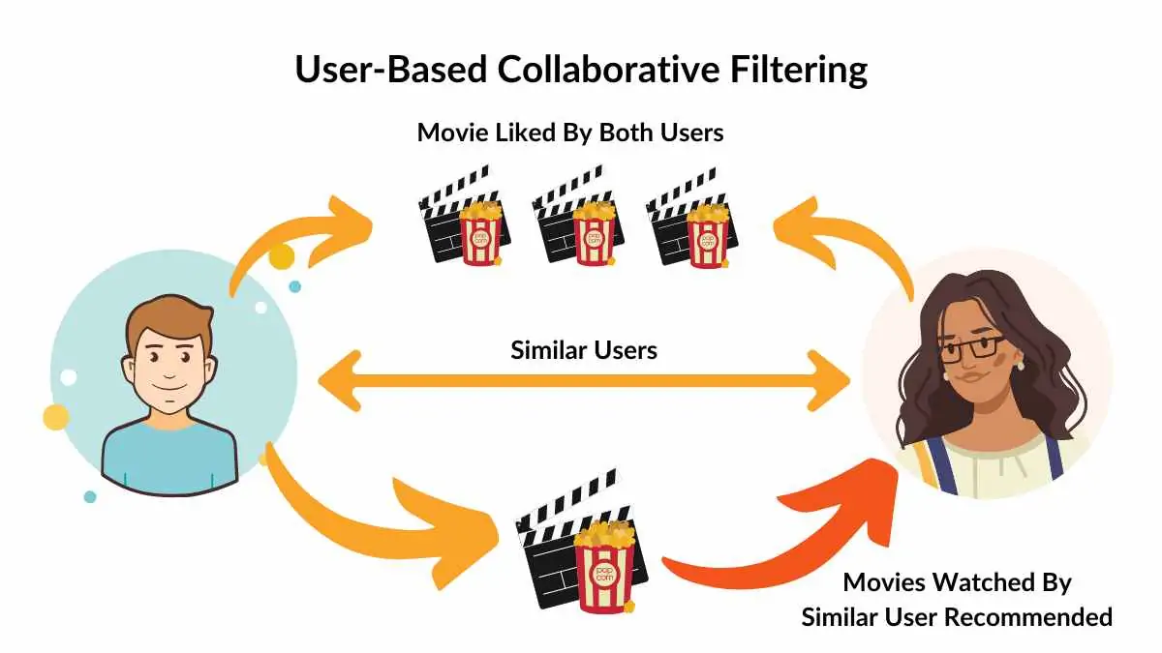
Collaborative based filtering
User Behavior Patterns: It analyzes users' past actions to detect trends and similarities.
Similar Users :Recommends items that users with similar interests have liked.
Diverse Recommendations : Introduces new items popular among similar users, helping with content discovery.

Slide 6

Hybrid approaches
Combines Multiple Methods: Integrates collaborative and content-based filtering, and sometimes other techniques, to leverage the strengths of each.
Improves Accuracy:
By blending methods, hybrid approaches make recommendations more accurate and relevant to the user.
Cross-Domain Recommendations: Uses data from other platforms

Slide 7
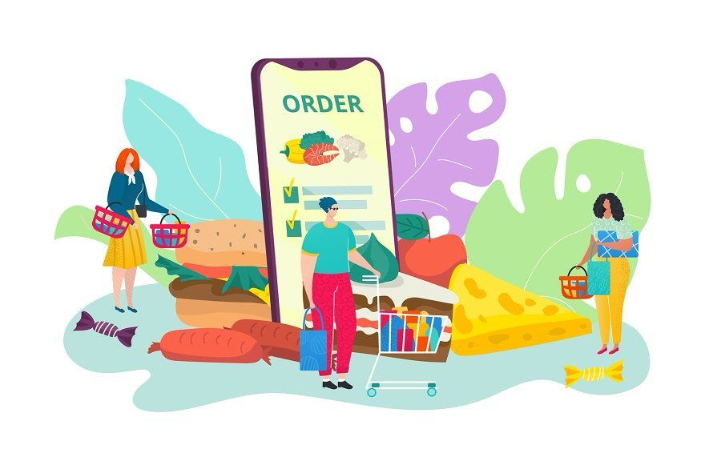
Recommend system on Swiggy
Content-Based
Collaborative
Hybrid approach
content-based filtering is used to recommend restaurants and dishes based on specific features that align with a user’s past preferences. This approach analyzes the attributes of food items and restaurants, such as cuisine type, ingredients, price range, and dietary categories
collaborative filtering is used to recommend restaurants and dishes based on the preferences and behavior of similar users. this analyzes user interactions, such as order history and ratings, to identify patterns among users with similar tastes.
a hybrid approach combines both content-based and collaborative filtering techniques to offer highly personalized food and restaurant recommendations. they use both data item features and user behavior

Slide 8

Content-Based recommendation in Swiggy
Cuisine-Based Recommendations:If a user frequently orders certain cuisines, like Italian or Chinese, Swiggy’s content-based system identifies this pattern and suggests similar restaurants or dishes within those cuisines.
Ingredient and Dish Type:Swiggy looks at details of dishes the user has ordered and recommends items with similar ingredients or types.
Favorite Restaurant Features:If the user frequently orders from particular restaurants with specific characteristics . Swiggy recommends other restaurants with similar features.
Example:If a Swiggy user often orders vegetarian Indian dishes, the app will prioritize similar items, such as vegetarian curries, biryanis, or thalis, from Indian restaurants. Additionally, it may suggest other Indian restaurants with similar items, keeping the recommendations relevant to the user’s preferences.

Slide 9
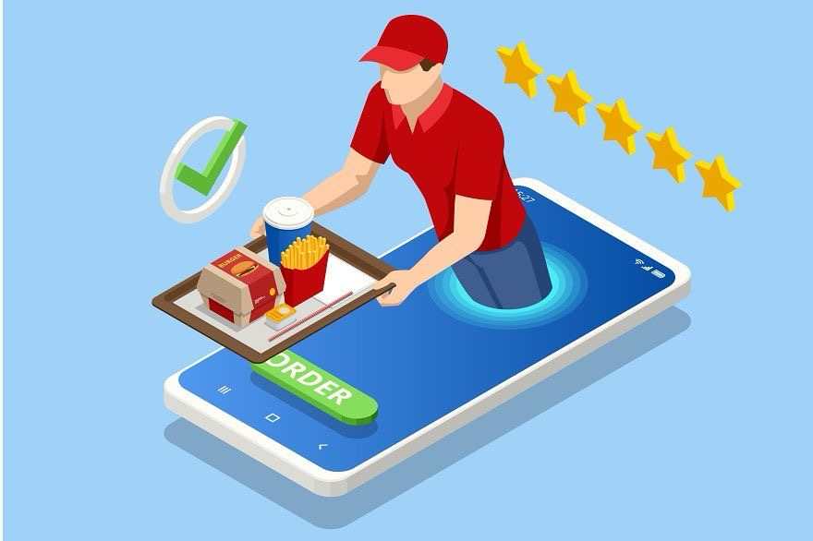
Collaborative-Based System In
Swiggy
“People Like You Also Ordered“
Recommendations: Swiggy analyzes what users with similar order histories have chosen and recommends those items to other users with matching tastes.
Personalized Restaurant Recommendations: Swiggy can recommend restaurants that users with similar profiles have repeatedly ordered from.
Example:If a Swiggy user often orders from Indian restaurants and other users with similar behavior also order from a popular North Indian restaurant, Swiggy’s collaborative filtering may recommend that North Indian restaurant to this user as well.

Slide 10
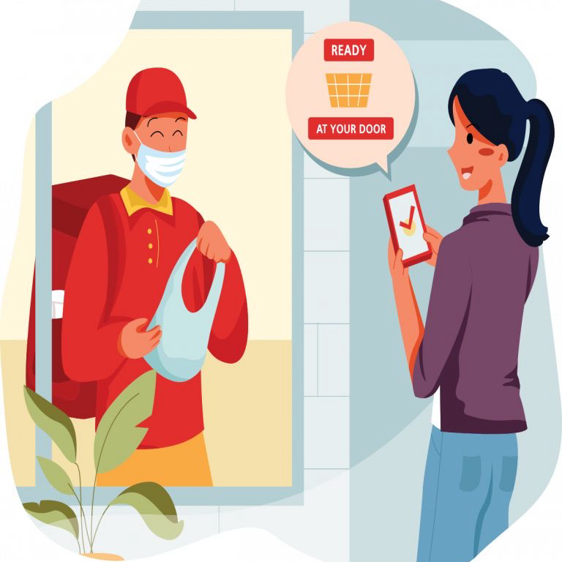
Hybrid Approach In Swiggy
Personalized Recommendations Using Both Preferences and Patterns:For existing users with order history, Swiggy combines collaborative filtering (analyzing similar users’ choices) with content-based filtering (based on specific item attributes like cuisine or dish type). This allows Swiggy to suggest options aligned with both user preferences and popular choices among similar users.
Example: Suppose a Swiggy user often orders vegetarian Italian dishes. Swiggy’s hybrid approach might recommend a new Italian restaurant (content-based) and suggest popular vegetarian pasta dishes from that restaurant, based on what similar vegetarian users have liked (collaborative filtering).

Slide 11
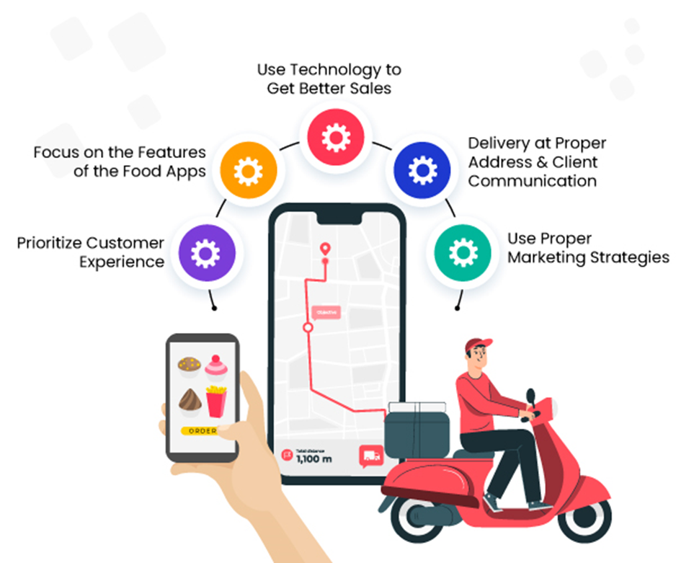
Conclusion: Enhancing the Swiggy app
Swiggy, the popular food delivery platform, uses a hybrid recommendation system as well. This type of system combines collaborative filtering, content-based filtering, and sometimes even knowledge-based recommendations to enhance the user experience.

